Slide 1
10th ETSI ITS Workshop
CEPT/ECC Activities on ITS
Presenter - Andy Gowans
Chairman of the Short Range Device Group reporting to ECC Working Group FM
Sophia Antipolis, 04 March 2019
1

Slide 2



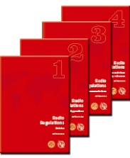

International Regulatory bodies
CEPT – ECC Deliverables
ECC Decisions
ECC Recommendations
Implemented Voluntarily
ECC Reports
Studies to back up decisions and CEPT reports
CEPT Reports
Report in response to EC mandate
Secretariat &
World Radio Conference (WRC-19)
Study Groups
RA-19
EU/EC Deliverables
EC Directive
EC Decisions
mandatory for member states
EC Mandate
to CEPT and ETSI
ITU Deliverables
Radio Regulations
Worldwide and regional allocations to different radio services
Satellite Filings
Registration of other services
International treaty status
ITU Deliverables
ITU-R Recommendations
ITU-R Reports
Voluntary Harmonisation and Technical Information documents

Slide 3





International Standards Engagement
CEN
CENELEC
CISPR
ETSI – CEN -CENELEC Deliverables
European Norms (EN)
Pseudo-Regulatory Standards
Technical Specifications (TS)
Voluntary Same status as other International standards
Technical Reports (TR)
Information to back up decisions and reports
SRDocs
Formal Request to CEPT for spectrum
International Standards
IEEE 802 (W-Fi, Bluetooth ZigBEE, 5G?, etc)
3GPP (CDMA, LTE 3G/4G/5G?)
CISPR IEC (EMC Standards)

Slide 4

Structure of the ECC
Structure of the ECC
Electronic
Communications Committee
Chairman: C. Woolford (G)
Vice-Chairmen: S. Pastukh (RUS)
J. Afonso (POR)
Steering Group
European
Communications Office
Director: P. Christensen (DNK)
Deputy Director: F. McBride (IRL)
WG CPG
WG FM
WG SE
WG NaN
ECC PT1
Conference
Preparatory Group
Frequency
Management
Spectrum
Engineering
Numbering
and Networks
IMT-Matters
Chairman:
A. Kühn (D)
Vice-Chairmen:
G. Osinga (HOL)
A. Kholod (SUI)
Chairman:
T. Weilacher (D)
Vice-Chairmen:
S. Talbot (G)
V. Durepaire (F)
Chairman:
J. André (F)
Vice-Chairmen:
I. Stevanovic (SUI)
k. Bejuk (HRV)
Chairman:
J. Vallesverd
(NOR)
Vice-Chairmen:
E. Greenberg (G)
V. Krastev (D)
Chairman:
S. Green (G)
Vice-Chairmen:
V. Milas (GRC)
E. Tonkikh (RUS)
Updated: February 2019

Slide 5
WGFM Organisation
ECC
EFIS/MG
ECO Frequency Information
System Maintenance Group
Chairman: Stefan Mayer-Bidmon (D)
WGFM
Working Group Frequency Management
Chairman: Thomas Weilacher (D)
Vice Chairman: Stephen Talbot (G)
Vice Chairman: Vincent Durepaire (F)
SRD/MG
Short Range Devices
Maintenance Group
Chairman: Andy Gowans (G)
ECO
Expertise and support
FM22 – Spectrum Monitoring and
Enforcement
Chairman: Ralf Trautmann (D)
WGFM Civil Military Forum
FM44 – Satellite Communications
Chairman: Amar Saidani (F)
External Relations
European Commission
ETSI
Other MoU/LoU Partners
WGFM Correspondence Groups
Drones: Chairman - Florian Cziczatka (AUT)
FM51 – PMSE
Chairman: Lindsay Cornell (G)
FM56 – Radio Spectrum for
Railway Applications
Chairman: Vincent Durepaire (F)
FM Radio Amateur FG
WGFM Radio Amateur Forum Group
Chairman: Thomas Weber (ECO)
FM57 – WAS/RLAN above 5 GHz
Chairman: Stephen Talbot (G)
FM58 – Maritime Group of WG FM
Chairman: Aire Siinvert (EST)
Support from ECO, the permanent office established in Copenhagen
FM59 – Unmanned Aircraft Systems(UAS)
Chairman: Oliver Keden (D)
European Process of standardisation and regulation for radiocommunication devices
and systems, inter-alia co-operation between CEPT and ETSI or work under mandates
from the EC.
Updated: September 2018

Slide 6
ITS studies and spectrum regulations
  ECC Decision (09)01 (ERC/REC 70-03 - Annex 13) and EC DEC 2006/771/EC (amended by (EU) 2017/1483) for ITS in 63-64 GHz including hybrid radar and vehicle communications systems;
  SRD regulation in ERC/REC 70-03 - Annex 1 and EC DEC 2006/771/EC (amended by (EU) 2017/1483) for 5725 - 5875 MHz;
  Road Tolling: 5795-5815 MHz incl. in ERC/REC 70-03 - Annex 5 and EC Decision 2006/771/EC (amended by (EU) 2017/1483) for SRD;
Existing compatibility studies for 5.9 GHz ITS are mainly in ECC Reports 101 and 228; and now in ECC Report 290.
IN THE UK ITS IS ALLOCATED ON A LICENCE EXEMPT BASIS (NON PROTECTED, NON INTERFERENCE BASIS)
IT SHOULD BE NOTED THAT THE CURRENT ALLOCATIONS FOR SAFETY RELATED ITS ARE ON A NON-EXCLUSIVE BASIS AND ITS TECHNOLOGIES WILL BE EXPECTED TO COPE WITH INTERFERENCE FROM OTHER INCUMBENT SYSTEMS (i.e. FS and FSS)

Slide 7
5GHz spectrum allocation in UK
5.0 | 5.025 | 5.05 | 5.075 | 5.1 | 5.125 | 5.15 | 5.175 | 5.2 | 5.225 | 5.25 | 5.275 | 5.3 | 5.325 | 5.35 | 5.375 | 5.4 | 5.425 | 5.45 | 5.475
 |  |  |  |  |  | Satellite |  |  |  | Earth Exploration Satellite Service and Space Research
Aeronautical Navigation Aid System |  |  |  |  |  |  |  |  |  |  |  |  |  | Aircraft
MOD
 |  |  |  |  |  | Wi-Fi indoor fixed and mobile
Feeder links, N-GSO, used by Globalstar
SARs/
5.5 | 5.525 | 5.55 | 5.575 | 5.6 | 5.625 | 5.65 | 5.675 | 5.7 | 5.725 | 5.750 | 5.775 | 5.8 | 5.825 | 5.85 | 5.875 | 5.9 | 5.925 | 5.95 | 5.975
 |  |  | Amateur Radio |  |  |  |  |  |  |  |  |  | A. R.
 |  |  |  | MET Office |  | Space Research |  |  | Satellite
PMSE |  |  |  |  |  |  | PMSE |  |  |  | PMSE |  |  | PMSE |  |  | Fixed links
MOD
Wi-Fi indoor and outdoor fixed and mobile |  |  |  |  |  |  |  |  | Wi-Fi indoor and outdoor fixed |  |  |  |  | Non-safety ITS | Safety ITS
 |  |  |  |  |  |  |  |  | Short Range Devices (SRD) |  |  |  |  |  |  | New ITS band
GSO satellites. More heavily used above 5850

Slide 8

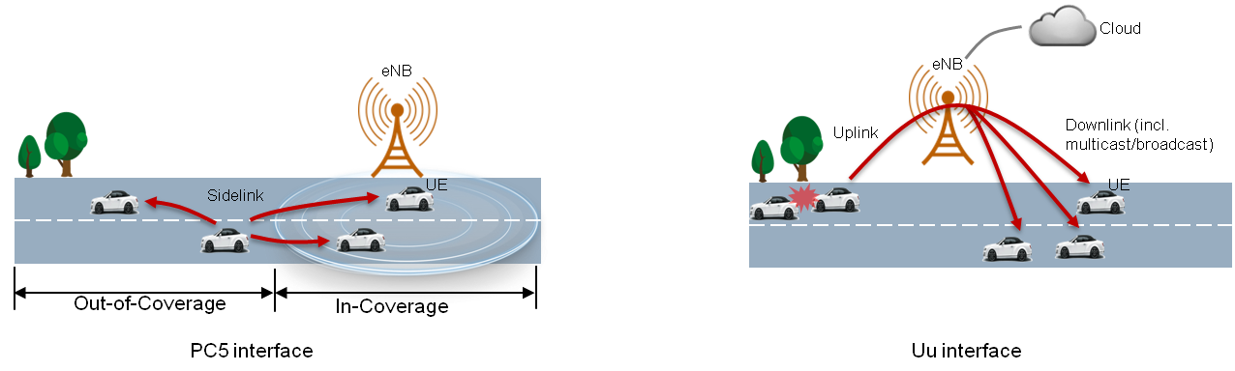

ITS and urban rail
ITS Spectrum and Characteristics:
5.9 GHz ➔ None Line-of-sight 300-1000m
63 GHz ➔ Line-of-sight > 100m
UK/European Spectrum regulations
Mandatory
5875-5905 MHz, EC decision 2008/671/CE and ECC decision ECC/DEC/(08)01, for safety-related ITS application, a.k.a. Cooperative ITS (C-ITS) and vehicle-to-x communications (V2X)
Optional
5855-5875 MHz, ECC recommendation ECC/REC/(08)01, for non-safety ITS applications shared with SRD/ISM
5905-5925 MHz, ECC Decision ECC/DEC/(08)01, as extension band for ITS
62-64 GHz, ECC decision ECC/DEC/(09)01
Possible Global Harmonisation (WRC-19)
Agenda Item 1.12 looking at possible harmonisation in the 5875-5925 MHz and the 62-64 GHz ranges

Slide 9
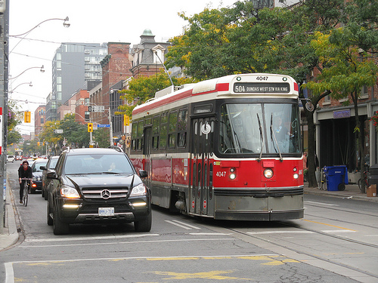


ITS and urban rail
COMPETING SPECTRUM USERS A BIG ISSUE
  ITS Road vs Urban Rail
  Wi-Fi vs ITS in 5.9GHz
  V2X vs V2V communications
  ITS technologies LTE V2X vs G5 802.11p
  Demarcation between commercial and safety related ITS
  Harmonisation, how much spectrum is needed?
5.9 GHz
64 GHz
Trams Road-ITS not Urban Rail ITS
Bluetooth, Wi-Fi
LTE-LAA, Multi-fire
5.9 GHz
64 GHz
Bluetooth, Wi-Fi
LTE-LAA, Multi-fire
C-ITS
ITS network infrastructure being rolled out today by Highways England in projects on the M42 and A2/M2. The A2/M2 project is part of a European connected corridor which runs thro’ to Germany.

Slide 10
EC Mandates
EC Mandate to CEPT to study the extension of the Intelligent Transport Systems (ITS) safety-related band at 5.9 GHz
  Extending the upper edge of the EC harmonised safety-related ITS band (5875-5905 MHz) by 20 MHz up to 5925 MHz;
  In addition to road transport, allowing other means of transport such as Urban Rail using Communication Based Train Control (CBTC) in the EC harmonised safety-related ITS band.
Permanent EC Mandate to CEPT on SRD (currently 7th update)
  Concerns non-safety related ITS in 5855-5875 MHz;
  Concerns new Smart Tachograph, Weight and Dimensions Applications in 5795 – 5815 MHz (so far available for road tolling);
  Concerns also ITS in 60 GHz.
Draft CEPT Report 71 (ITS) and Draft CEPT Report 70 (SRD) for Final Approval this week @ at CEPT/ECC meeting.

Slide 11
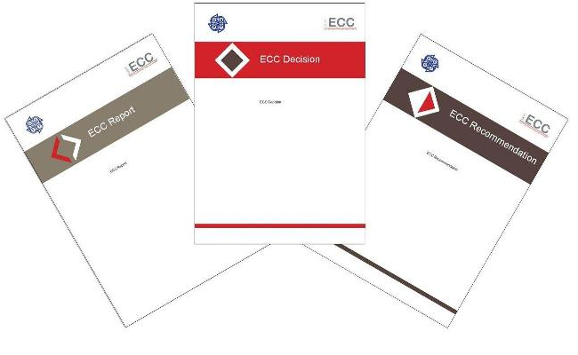
Planned Output
CEPT Reports 70 and 71 – Proposals for modification of related Commission Implementing Decisions (to be discussed within DG Connect / Radio Spectrum Committee meetings).
Revision ECC Decision (08)01 – ITS (safety-related) in 5875-5925/5935 MHz.
Revision ECC Recommendation (08)01 – ITS (non-safety) in 5855-5875 MHz.
Inclusion in ERC/REC 70-03, e.g. Smart Tachograph and Weight and Dimension applications.
Revision ECC Decision (09)01 on ITS in 63 – 64 GHz (part of the review of the band 57 – 71 GHz).

Slide 12
Technologies under Consideration
Road ITS - ITS-G5 and LTE-V2X. LTE-V2X uses in the 5.9 GHz band only the PC5 air interface. ITS-G5 is based on IEEE 802.11/11p specifications. V2X based on 3GPP LTE spec
Urban Rail (CBTC) ITS: DSSS/TDMA, full or modified IEEE 802.11 technology, OFDM based, 3GPP TD-LTE (used in China at 1.8 GHz, not implemented in Europe yet).

Slide 13
Organisation & Timeline
24 - 28 September 2018 – WG FM #92
Finalisation of draft CEPT Reports 70 and 71.
23 - 26 October 2018 – ECC#49
Approval for public consultation of draft CEPT Reports 70 and 71.
05 – 06 December 2018 – RSC#66
Introduction of draft CEPT Reports 70 and 71, first discussions.
19 - 21 December 2018 – SRD/MG#75
Comments resolution meeting after PC.
04 – 08 February 2019 – WG FM #93
Finalisation of amended draft CEPT Reports 70 and 71 after PC.
05 – 08 March 2019 – ECC #50
Final approval of CEPT Reports 70 and 71, submission to the European Commission (DG Connect).

Slide 14
Conclusions of draft CEPT Report 71 on ITS
Draft CEPT Report 71 is available (Annex 11 to doc. FM(19)075):
https://www.cept.org/ecc/groups/ecc/wg-fm/client/meeting-documents/
Changes are still possible until the final approval (March 2019).
EC is invited to consider the following:
Road ITS and Urban Rail ITS applications should be part of the same spectrum regulatory framework.
Safety Related Road ITS applications are currently using frequencies in 5875-5905 MHz in accordance with the existing EC and ECC Decisions, Urban Rail ITS applications are using frequencies on a national basis in the 2.4GHz band and above 5905 MHz across CEPT.

Slide 15
Conclusions of draft CEPT Report 71 on ITS
EC is invited to consider the following (cont.):
FS applications are widespread above 5925 MHz, and therefore Road ITS applications are not considered in this report above 5925 MHz unless a proper study is performed.
The frequency regulation should ensure technology neutrality, enable early launch of ITS products, yet take special care to avoid one technology to pre-empt use of all the spectrum or interfere with other technologies.

Slide 16
Conclusions of draft CEPT Report 71 on ITS
EC is invited to consider the following (cont.):
Defining sharing priority between different ITS applications is not against the principle of technology neutrality, as it prevents segmentation and would provide certainty and clear regulatory framework to all ITS applications. Road ITS and Urban Rail ITS should remain confined to their respective prioritised frequency range only until they implement polite protocols and/or a proper sharing mechanism to be defined by ETSI.

Slide 17
Conclusions of draft CEPT Report 71 on ITS
EC is invited to consider the following (cont.):
To harmonize the frequency band 5875-5925 MHz for safety-related ITS applications. In addition, to harmonize the frequency band 5925-5935 MHz for safety-related Urban Rail ITS applications, subject to national co-ordination with FS Networks and/or national studies to determine the sharing conditions.
The regulatory framework should define priority to Road ITS applications below 5915 MHz and to Urban Rail ITS applications above 5915 MHz, so that protection from other ITS applications is afforded to the ITS application having priority.

Slide 18
Conclusions of draft CEPT Report 71 on ITS
EC is invited to consider the following (cont.):
In absence of solutions allowing Road ITS applications to protect of Urban Rail ITS applications in the frequency range 5915-5925 MHz, on a national basis Road ITS applications limited to vehicle-to-infrastructure (V2I) applications may be permitted with co-ordinated use in this band; Vehicle-to-vehicle (V2V) could be permitted when solutions ensuring protection of Urban Rail ITS become available from standardisation in ETSI.
The precise way how this can be best facilitated for Urban Rail ITS is within the national authorisation process based on national coordination. This would imply the use of individual authorisations for Urban Rail ITS (5915-5935 MHz), Road ITS infrastructure (5915-5925 MHz) and FS (above 5925 MHz).

Slide 19
Conclusions of draft CEPT Report 71 on ITS
EC is invited to consider the following (cont.):
CEPT is suggesting reviewing the EU framework after no more than 3 years, taking into account the progress made on technology-neutral co-channel sharing mechanisms between ITS applications.
CEPT invited ETSI to develop sharing and interference mitigation techniques with a reasonable time-frame (no more than 3 years), for ensuring co-channel coexistence in the frequency range 5875-5925 MHz between Road ITS and Urban Rail applications and between Road ITS radio technologies.
A separate response to an EC mandate on possible RLAN use above 5925 MHz is being worked on in CEPT to define suitable Technical conditions for RLAN operating above 5925 MHz

Slide 20
Finally..
Thank you very much
Further information on:
www.cept.org/ecc

